Slide 1
ONAP – Introduction

Slide 2
Agenda
Introduction
Why, What and How of ONAP
ONAP – Quick Peek
Architecture modules
Design Time vs Run Time
Participate, Contribute and Collaborate
ONAP Participation
How to contribute
Cross Community Collaboration
ONAP vs Other OSSs

Slide 3
What is ONAP?
“The ONAP project was formed in March 2017 in response to a rising need for a common platform for telecommunication, cable and cloud operators – and their solution providers – to deliver differentiated network services on demand, profitably and competitively, while leveraging existing investments.”

Slide 4


Why ONAP : Automating the Network

Slide 5
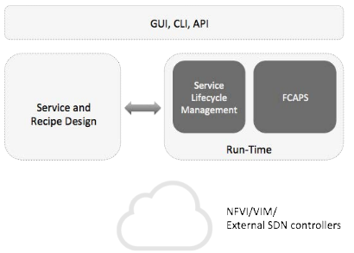
How ONAP Works
ONAP is a platform to orchestrate the lifecycle of xNFs in an SDN.
ONAP is a composition of several applications.
ONAP is divided in 2 main functional areas:
design & run-time.

Slide 6
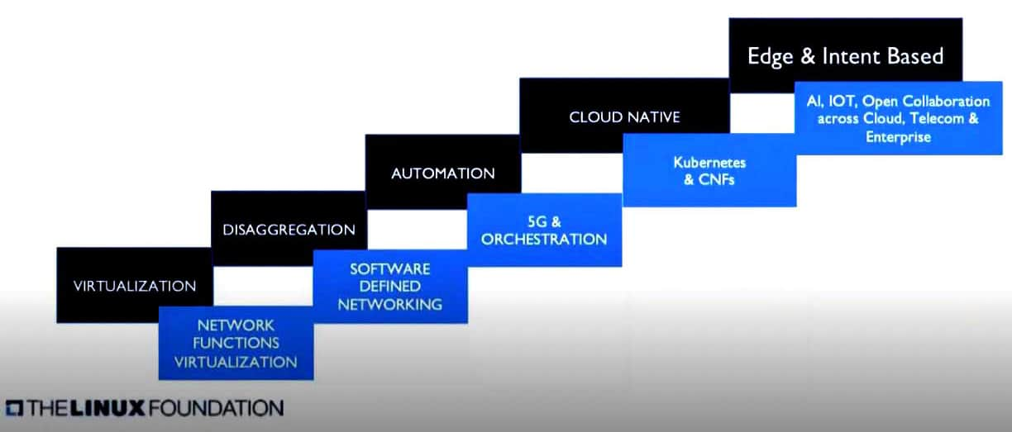
Technology disruption and rise of open source

Slide 7
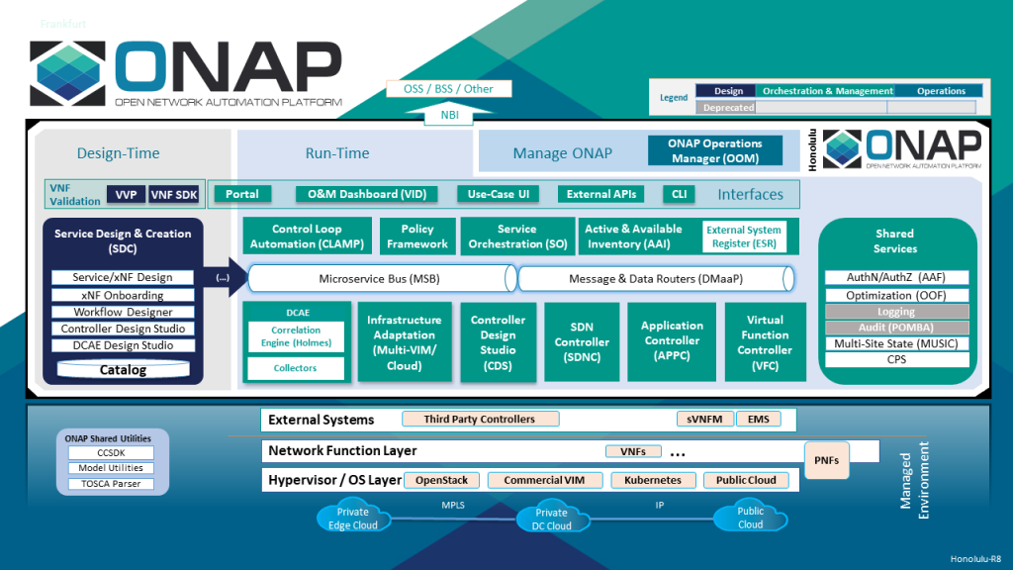
ONAP Architecture

Slide 8
ONAP Projects and Their Scopes
GUI / CLI / Portal / VID
Design Time
Run Time
Control Loop
SDC
SO
DCAE
CCSDK
SDNC
Policy
CPS
AAI
Clamp
CDS
CDS
CDS
Policy
CPS
AAI
DMaaP / MSB

Slide 9
ONAP Use Case – Design Time – Onboarding
Upload descriptive model of the virtual function (Heat, TOSCA, Helm)
Validate, assign, license, certify virtual function
Create catalog entry, assign data/metadata
Distribute for instantiation

Slide 10
ONAP Use Case – Run-Time
Instantiate virtual functions
LifeCycle: start / stop / reset / scale up / scale down / configure…
Monitoring metrics
Control loops

Slide 11
ONAP Control Loop
The core/main ONAP components involved in C.L. are: DCAE, CLAMP, Policy and SO.
A Control Loop does several functions:
Collect data about VNFs or VNF infrastructure
Compute analytics based on collected data
For open loop, send message to ticketing system for human intervention
For closed loop, execute one of many actions to remediate the network condition
For closed loop, detect that a network condition has been corrected through our actions

Slide 12
ONAP Control Loop – Design Time
Choose/create microservices sequence that makes the Control Loop
Binding to a VNF in a Service
Choose from pre-existing sequence
Build a brand new sequence
Generate model file (YAML and cloudify blueprint) to be distributed to run-time part of control loop (DCAE/CLAMP)

Slide 13
ONAP Control Loop Run-Time
Configuring the Control Loop
Driven by the VNF (list of alarms,…)
Configuring microservices parameters values (configuration policies)
Configuring the action to be taken (operational policy)
Trigger Deployment of Control Loop
Trigger API exposed by DCAE
Lifecycle Management of the Control Loop
Stopping/restarting/updating configurations
Monitoring (status of the C.L.)

Slide 14
ONAP Control Loop Run-Time
Closed Loop Flow’s
Analytics Micro service x: “TCA”, “Holmes”, …
Signature
Drools Policy
datan
data1
Analytics Micro service 1
DMaaP
PDP- POLICY engine
DMaaP
DMaaP
Analytics Micro service n
Events/
Alarms
Action
Collector
(VES, SNMP, …)
Docker/CDAP
Docker/CDAP
DMaaP/REST
Docker/CDAP
DCAE
Action Execution
…
VNF
Action’s
Action Execution
Action Execution
App-C
SO

Slide 15
